Slide 1
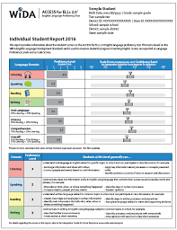

2025 ACCESS & Alternate ACCESS Score Reports
Middle Township Elementary Schools
July 17, 2025

Slide 2
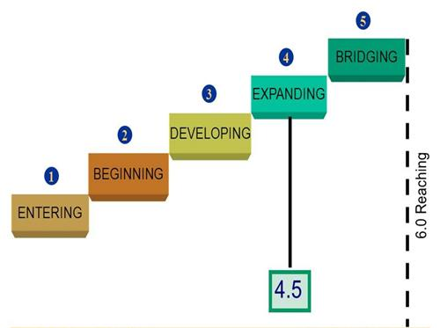
WIDA Proficiency Levels
Per the state of New Jersey Department of Education, students must achieve a proficiency level of at least 4.5 to exit our English as a Second Language (ESL) Program.

Slide 3
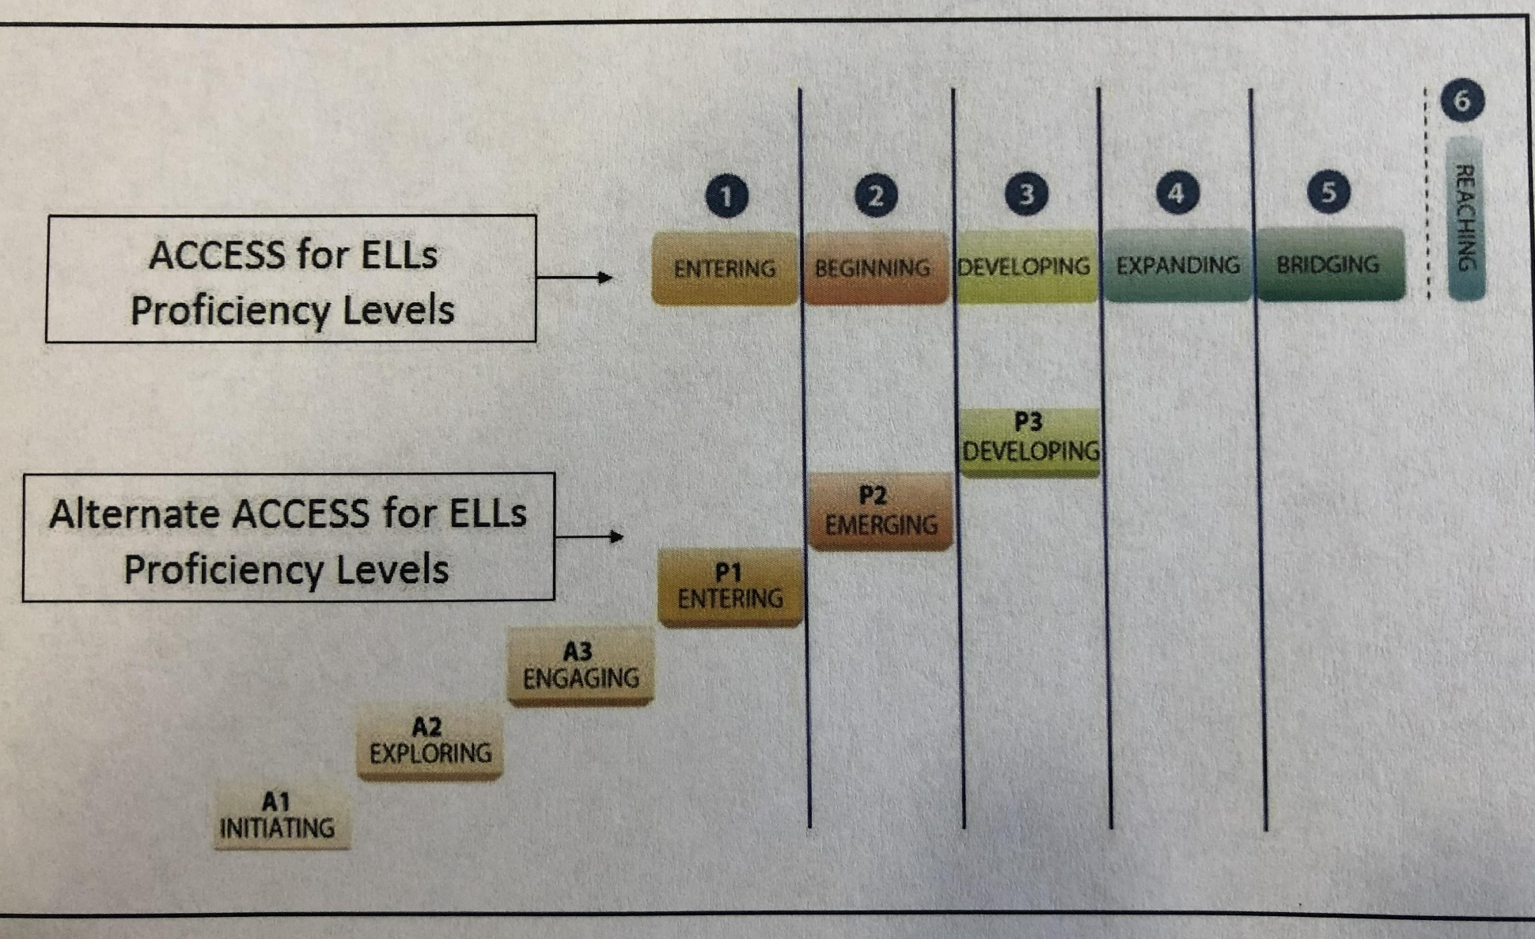
Alternate ACCESS Proficiency levels
Qualifying students with disabilities can take an Alternate ACCESS test and exit our ESL program with a score of P1- Entering.

Slide 4
Kindergarten Frequency Report
Proficiency Level | Overall Score
 | # of Students at Level | % of Total Tested
1- Entering | 17 | 71%
2- Emerging | 2 | 8%
3- Developing | 2 | 8%
4- Expanding | 2 | 8%
5- Bridging | 0 | 0%
6- Reaching | 0 | 0%
Total Tested: 24

Slide 5
1st Grade Frequency Report
Proficiency Level | Overall Score
 | # of Students at Level | % of Total Tested
1- Entering | 2 | 7%
2- Emerging | 12 | 41%
3- Developing | 15 | 52%
4- Expanding | 0 | 0%
5- Bridging | 0 | 0%
6- Reaching | 0 | 0%
Total Tested: 29

Slide 6
2nd Grade Frequency Report
Proficiency Level | Overall Score
 | # of Students at Level | % of Total Tested
1- Entering | 0 | 0%
2- Emerging | 4 | 20%
3- Developing | 15 | 75%
4- Expanding | 1 | 5%
5- Bridging | 0 | 0%
6- Reaching | 0 | 0%
Total Tested:20

Slide 7
3rd Grade Frequency report
Proficiency Level | Overall Score
 | # of Students at Level | % of Total Tested
1- Entering | 1 | 6%
2- Emerging | 4 | 24%
3- Developing | 8 | 47%
4- Expanding | 3 | 18%
5- Bridging | 1 | 6%
6- Reaching | 0 | 0%
Total Tested:17

Slide 8
4th Grade Frequency Report
Proficiency Level | Overall Score
 | # of Students at Level | % of Total Tested
1- Entering | 1 | 9%
2- Emerging | 1 | 9%
3- Developing | 5 | 45%
4- Expanding | 4 | 36%
5- Bridging | 0 | 0%
6- Reaching | 0 | 0%
Total Tested:11

Slide 9
5th Grade Frequency Report
Proficiency Level | Overall Score
 | # of Students at Level | % of Total Tested
1- Entering | 0 | 0%
2- Emerging | 4 | 44%
3- Developing | 2 | 27%
4- Expanding | 3 | 33%
5- Bridging | 0 | 0%
6- Reaching | 0 | 0%
Total Tested: 9

Slide 10
6th Grade Frequency Report
Proficiency Level | Overall Score
 | # of Students at Level | % of Total Tested
1- Entering | 3 | 30%
2- Emerging | 4 | 40%
3- Developing | 2 | 20%
4- Expanding | 1 | 10%
5- Bridging | 0 | 0%
6- Reaching | 0 | 0%
Total Tested:10

Slide 11
7th Grade Frequency Report
Proficiency Level | Overall Score
 | # of Students at Level | % of Total Tested
1- Entering | 0 | 0%
2- Emerging | 4 | 40%
3- Developing | 6 | 60%
4- Expanding | 0 | 0%
5- Bridging | 0 | 0%
6- Reaching | 0 | 0%
Total Tested:10

Slide 12
8th Grade Frequency Report
Proficiency Level | Overall Score
 | # of Students at Level | % of Total Tested
1- Entering | 1 | 10%
2- Emerging | 3 | 30%
3- Developing | 5 | 50%
4- Expanding | 1 | 10%
5- Bridging | 0 | 0%
6- Reaching | 0 | 0%
Total Tested:10

Slide 13
9th Grade Frequency Report
Proficiency Level | Overall Score
 | # of Students at Level | % of Total Tested
1- Entering | 4 | 40%
2- Emerging | 3 | 30%
3- Developing | 3 | 30%
4- Expanding | 1 | 0%
5- Bridging | 0 | 0%
6- Reaching | 0 | 0%
Total Tested:10

Slide 14
10th Grade Frequency Report
Proficiency Level | Overall Score
 | # of Students at Level | % of Total Tested
1- Entering | 2 | 20%
2- Emerging | 2 | 20%
3- Developing | 5 | 50%
4- Expanding | 1 | 10%
5- Bridging | 0 | 0%
6- Reaching | 0 | 0%
Total Tested:10

Slide 15
11th Grade Frequency Report
Proficiency Level | Overall Score
 | # of Students at Level | % of Total Tested
1- Entering | 2 | 40%
2- Emerging | 0 | 0%
3- Developing | 2 | 40%
4- Expanding | 1 | 20%
5- Bridging | 0 | 0%
6- Reaching | 0 | 0%
Total Tested:5

Slide 16
12th Grade Frequency Report
Proficiency Level | Overall Score
 | # of Students at Level | % of Total Tested
1- Entering | 3 | 75%
2- Emerging | 0 | 0%
3- Developing | 1 | 25%
4- Expanding | 0 | 0%
5- Bridging | 0 | 0%
6- Reaching | 0 | 0%
Total Tested:4

Slide 17
Exit/Entry/Continuation
Grade | Exit | Entry | Continuation
Kindergarten | 0 | 23 | 23
G1 | 0 | 3 | 25
G2 | 0 | 3 | 20
G3 | 0 | 3 | 15
G4 | 0 | 4 | 8
G5 | 2 | 1 | 8
G6 | 1 | 2 | 8

Slide 18
Exit/Entry/Continuation
Grade | Exit | Entry | Continuation
G7 | 0 | 0 | 10
G8 | 0 | 3 | 7
G9 | 0 | 4 | 7
G10 | 0 | 1 | 9
G11 | 0 | 0 | 4
G12 | 0 | 0 | 4
Totals | 3 | 47 | 125
Total = 175

Slide 19
Language Acquisition
How long does it take for a language learner to go through the language acquisition stages?
Just as in any other learning situation, it depends on the individual.
One of the major contributors to accelerated second language learning is the strength of first language skills. The general consensus is that it takes between five to seven years for an individual to achieve advanced fluency.
This generally applies to individuals who have strong first language and literacy skills. If an individual has not fully developed first language and literacy skills, it may take between seven to ten years to reach advanced fluency.
It is very important to note that every ELL student comes with his or her own unique language and education background, and this will have an impact on their English learning process.

Slide 20
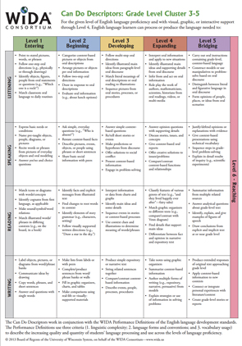
How we Use this Data to Inform Instruction
The ACCESS proficiency levels align to the World-Class Instructional Design and Assessment (WIDA) Can Do Descriptors. These descriptors highlight what students can do at various stages of language development across the domains of writing, reading, speaking and listening. Teachers can use the Can Do Descriptors to:
Better understand what students, at different levels of language proficiency, can do with language
Expand their understanding of what the process of language development can look look
Collaborate about scaffolding students need to engage in content-area learning and develop language at the same time
Differentiate instruction and classroom assessment for language

